Slide 1
MHLA
2024 “Stars of the Industry” Awards

Slide 2
2024 NOMINATIONS NOW BEING ACCEPTED!
Hotels must be a current MHLA member in good standing to nominate employees or property.
Deadline for entry
March 1, 2024

Slide 3
"Stars of the Industry" AWARDS LUNCHEON
MHLA winners will be selected from all of the nominees and will be announced at the luncheon.
Thursday, April 25, 2024 10:15 AM - 1:45 PM EST
BWI Airport Marriott Hotel
1743 West Nursery Road
Linthicum, MD 21090
10:15 A.M. -11:30 A.M. - Registration & Hotel Group Photos
11:30 A.M. -1:45 P.M. - Program to include Awards Luncheon
Click Here to Register or Sponsor

Slide 4
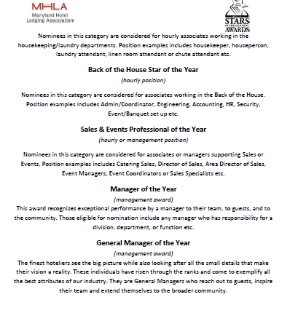
NOMINATION CRITERIA
MHLA Member Hotels are invited to submit 1 nominee in each of the categories for a maximum of 9 nominations per member.
Please note there are separate nomination forms for Property Nominations (1 max per property) and for Employee Nominations (8 max per property)
Click here for 2024 Nomination Criteria
(Please review before submitting nominations)

Slide 5
AWARD CATEGORIES
(1) PROPERTY AWARD Outstanding Property of the Year (8) EMPLOYEE AWARDS
Culinary & Kitchen Star of the Year (hourly position) . Food & Beverage Star of the Year (hourly position) Front Office & Guest Services Star of the Year (hourly position) Housekeeping Star of the Year (hourly position)
Back of the House Star of the Year (hourly position) Sales & Events Professional of the Year (hourly or management position) Manager of the Year (management award) . General Manager of the Year (management award)

Slide 6
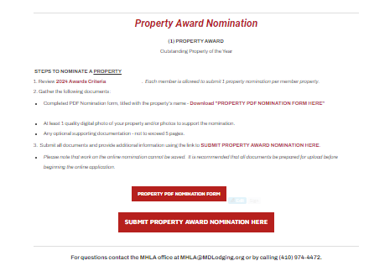
NOMINATION PREPARATION
Click Here for Nomination Webpage

Slide 7
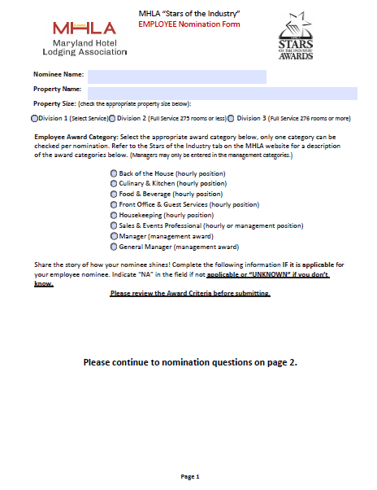
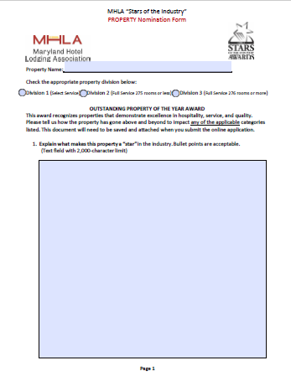
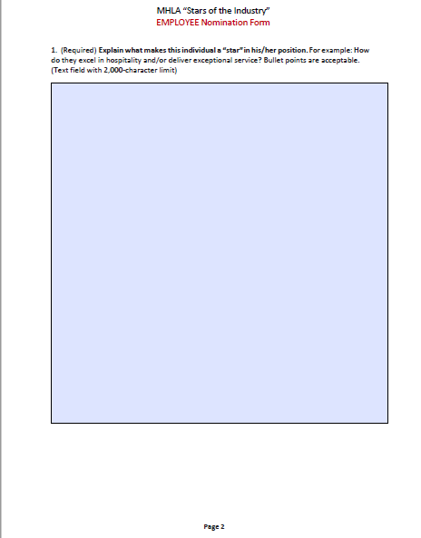
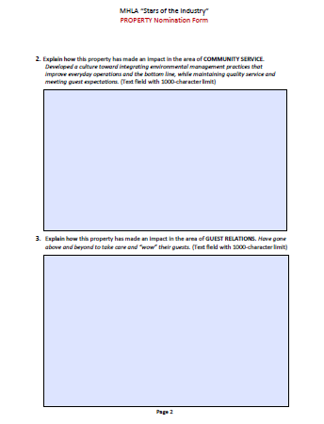
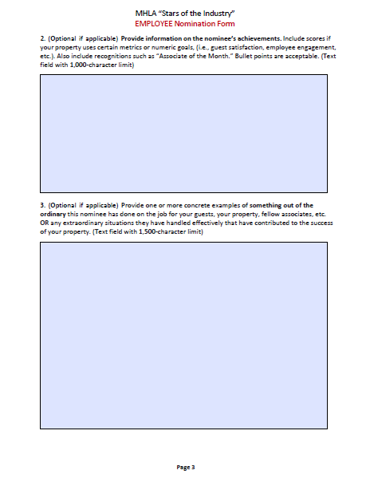
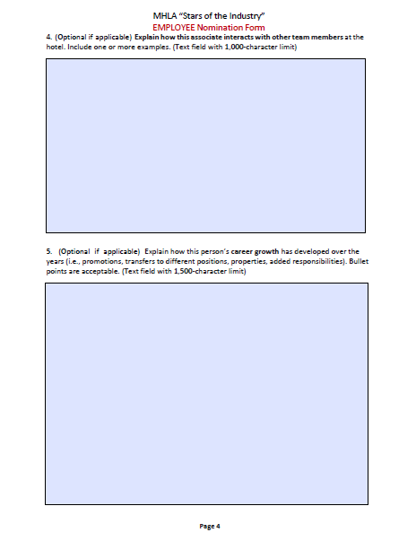
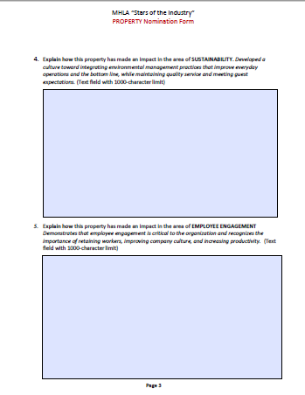
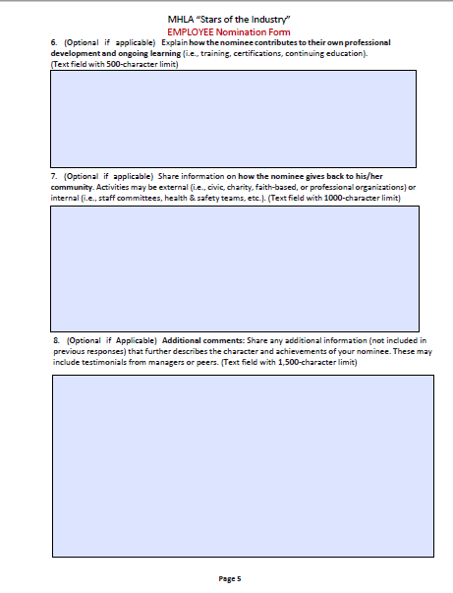
DOWNLOAD PDF NOMINATION FORMS
Employee
Property

Slide 8
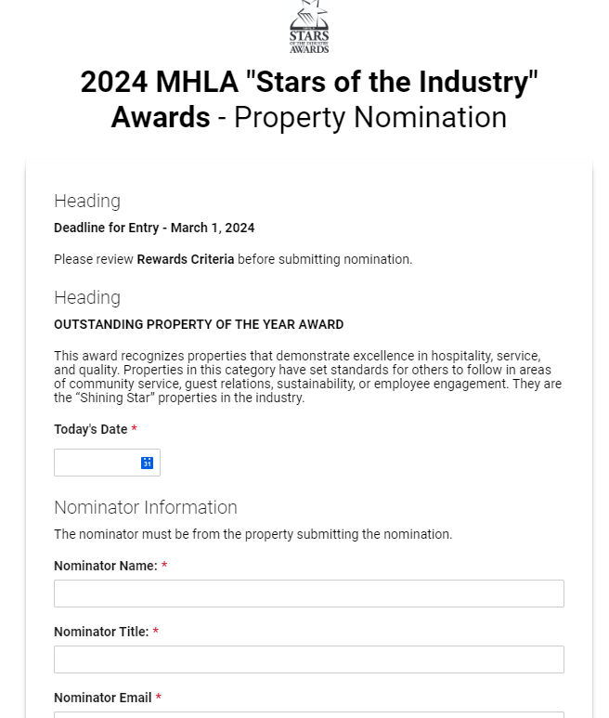
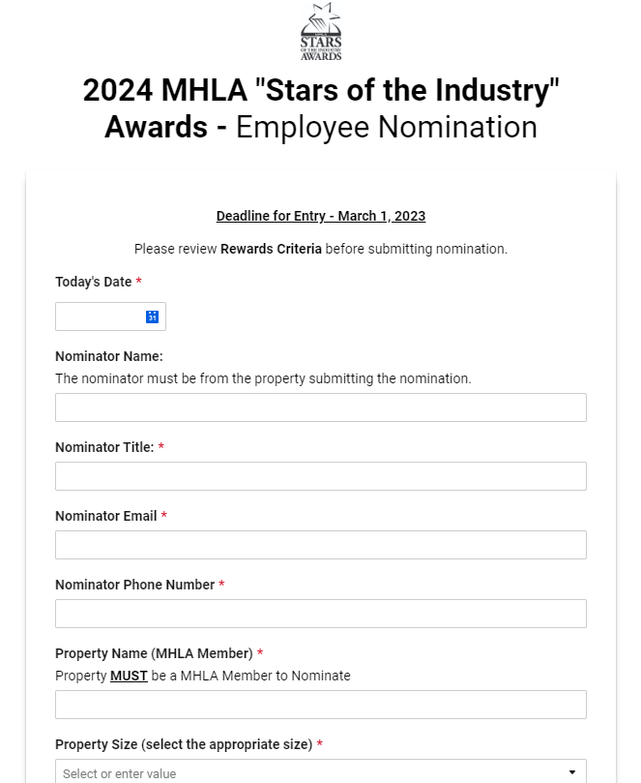
SUBMIT NOMINATION ONLINE
Click Here to view Property form
Click Here to view Employee form

Slide 9
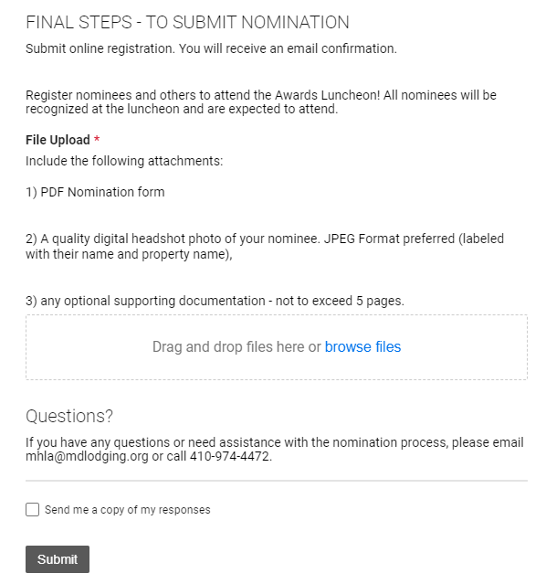
UPLOAD ATTACHMENTS

Slide 10
SUBMIT NOMINATION AND REGISTER NOMINEE(S)
All Employee Nominees are expected to attend the Annual Awards Luncheon as they will be recognized as your property's WINNER in each of the award categories.
Click Here to Register or Sponsor

Slide 11
THANK YOU

